Slide 1
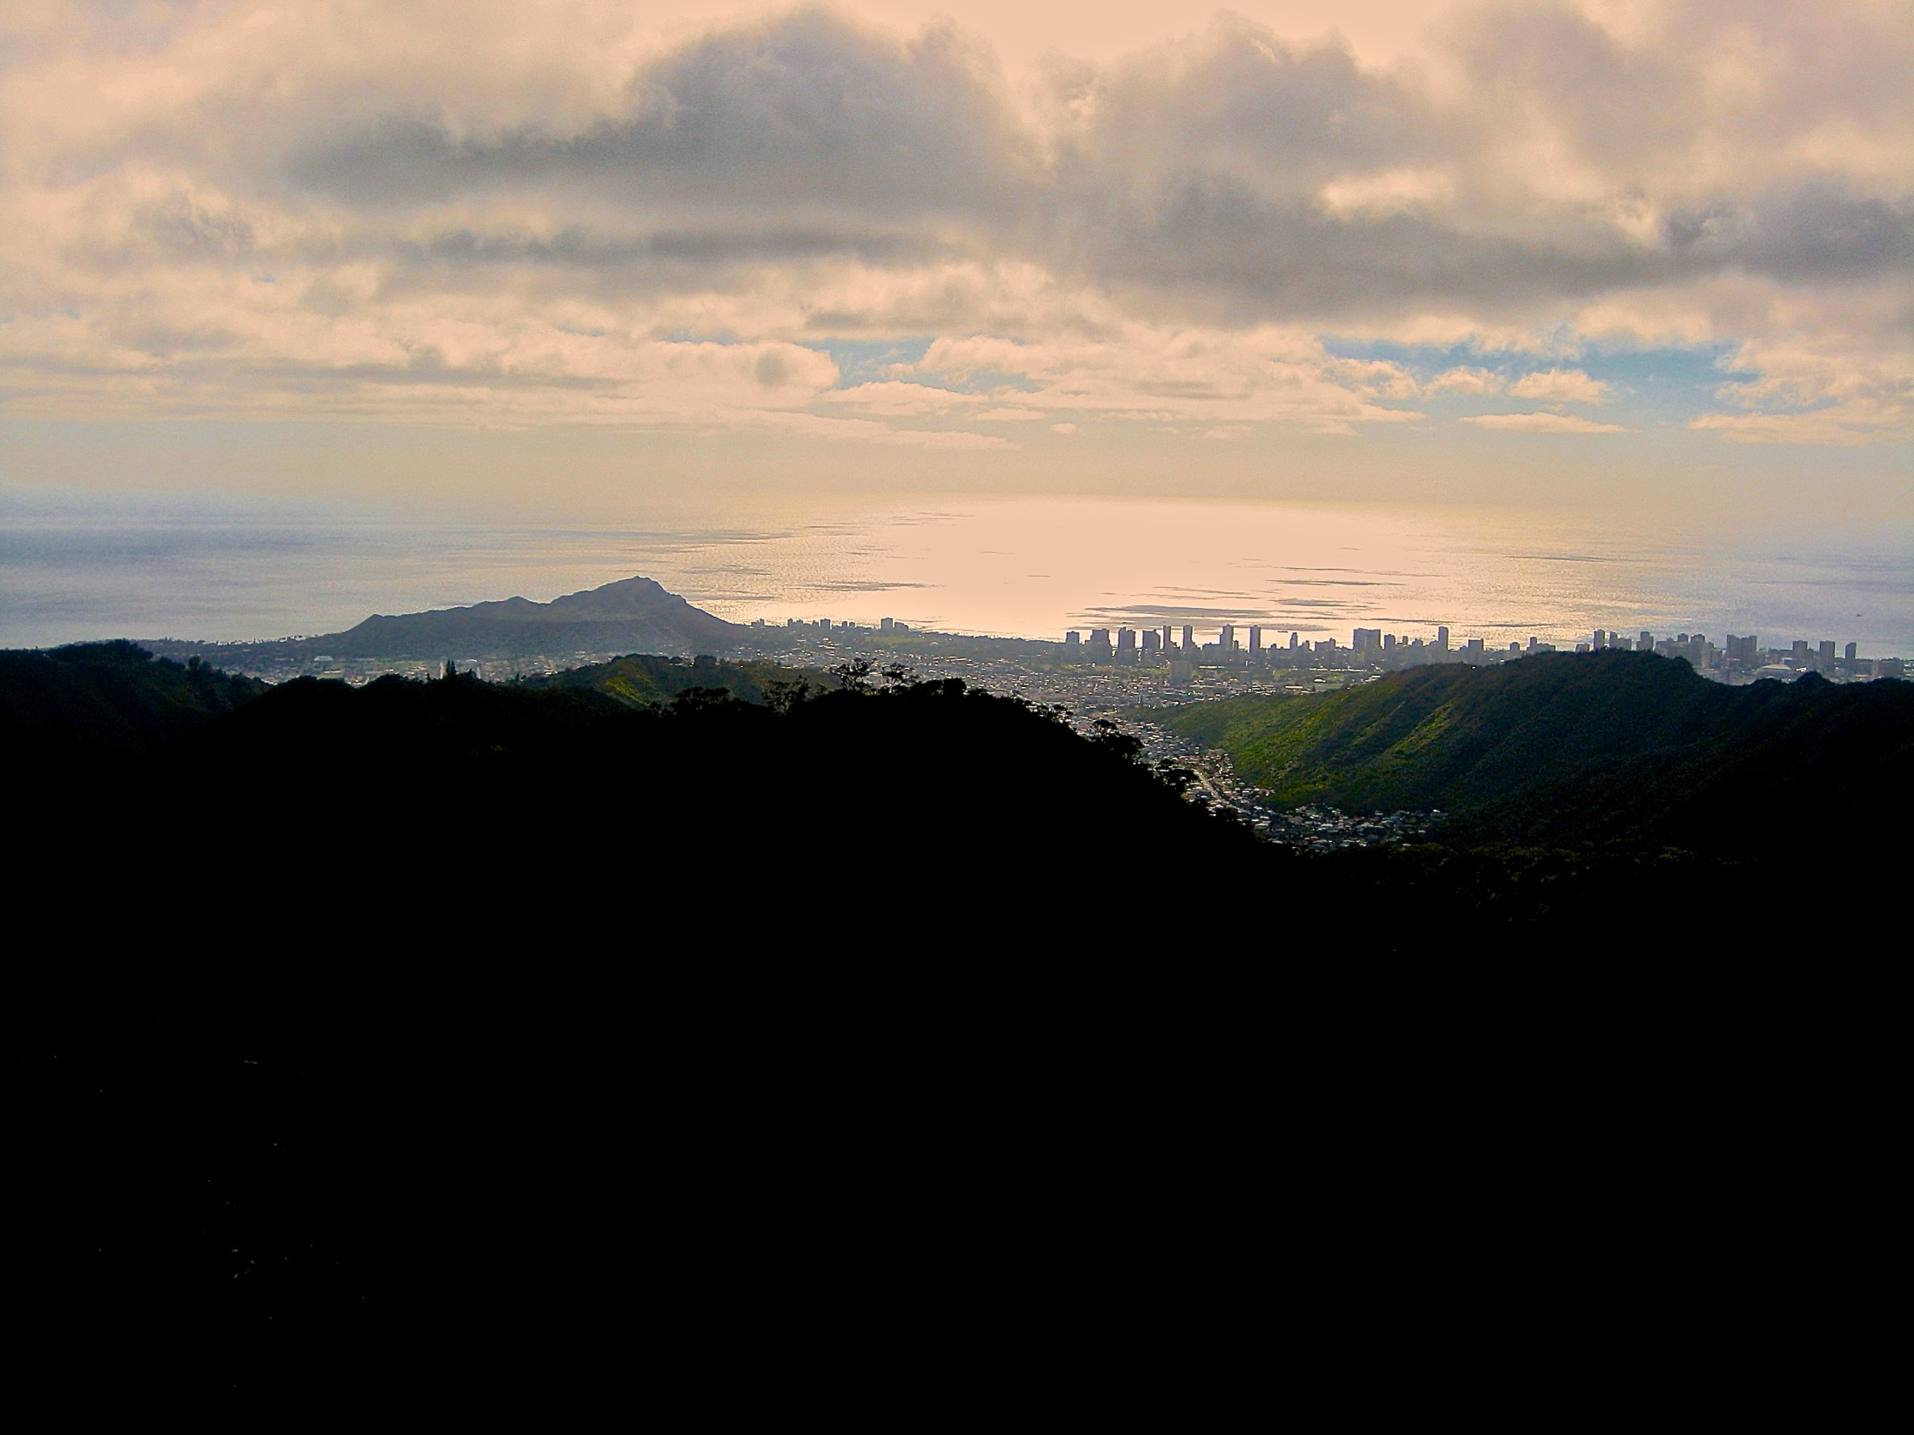
Neʻepapa Kalāhū “The sun emerges in unison.” Honoring and Re-connecting Past to Present, and Introducing the Future.
Come and relax, talk story, build connections, listen to music, have fun, strengthen community, and celebrate successes!
Thursday, August 20^{th,}
Pau Hana - 5:00-9:00 p.m.
KCC Great Lawn
For All KCC Employees & Guests (Adults only)
Cost: $10.00 per adult
Food provided by Noa Lu‘au
Non-alcoholic drinks provided by the KCC Aloha Club
Bring your own alcoholic beverages
RSVP By August 10th at http://goo.gl/forms/O5lSHPGXky
Photograph by: Joshua Clements

